Slide 1
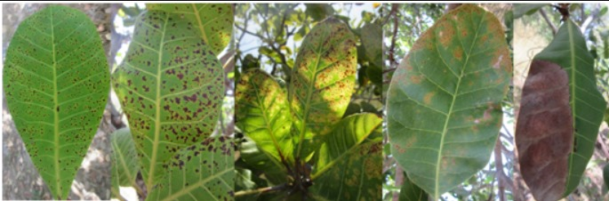

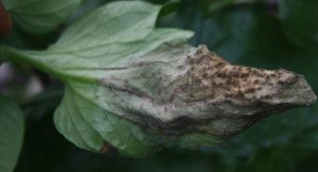
MINI PROJECT
Crop Disease Prediction and Pesticide Recommendation Using Deep Learning Techniques
REG NO :20MIA1031
NAME: SANJAY.M
GUIDE : Dr. RENUKA DEVI S

Slide 2
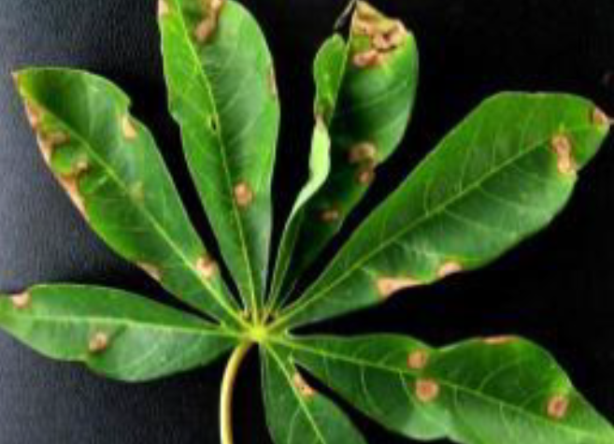
MINI PROJECT
outline
Outline
INTRODUCTION
LITERATURE REVIEW
SCOPE AND PROBLEM STATEMENT
DATASET
RESEARCH CHALLENGES
RESEARCH OBJECTIVE
LIMITATIONS
FUTURE WORK
CONCLUSION
GUIDE APPROVAL
REFERENCES
Next

Slide 3
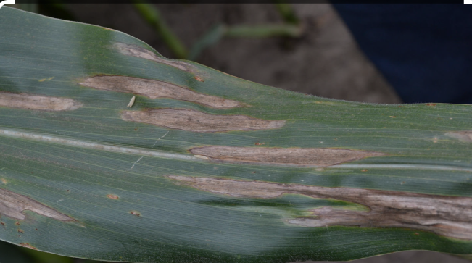
INTRODUCTION
MINI PROJECT
INTRODUCTION
Crop diseases provide substantial difficulties to Ghana farms, as they do in many other regions, threatening food security and economic stability.
Traditional approaches for identifying agricultural diseases and proposing appropriate pesticides frequently depend on time-consuming physical observations and are limited by a lack of data.
These constraints might cause delayed responses, lowering crop production and increasing vulnerability to food shortages.
Given these challenges, there is a critical need for novel ways that use modern technologies to improve the efficiency and accuracy of disease prediction and pesticide medications.
Crop disease prediction is an important feature of modern agriculture since early and accurate diagnosis of illnesses can considerably reduce their influence on crop output and provide food security.
Historically, disease prediction has relied mainly on physical inspections and agronomist expertise, both of which are time-consuming and prone to human error.
Furthermore, a lack of thorough data on numerous agricultural diseases, particularly in regions such as Ghana, has made it difficult to precisely predict epidemics.
This gap in prediction capabilities frequently results in delaying measures, allowing illnesses to grow uncontrolled and causing significant losses in agricultural productivity.
Next

Slide 4
INTRODUCTION
MINI PROJECT
INTRODUCTION
Machine Learning (ML) and Deep Learning (DL) have transformed crop disease prediction by allowing for the examination of massive datasets to uncover patterns and correlations that would otherwise go undetected using traditional methods.
These tools can accurately anticipate the risk of disease outbreaks by processing data from multiple sources, such as crop photographs, weather variables, and historical illness records.
By combining these complex methodologies with real-world and synthetic datasets, as presented in this paper, we can create predictive models that are not only more accurate but also adaptable to a variety of crop varieties and environmental situations.
This strategy has the potential to improve crop disease management, resulting in more prompt and effective responses that safeguard crops and assure stable food supplies.
Next

Slide 5
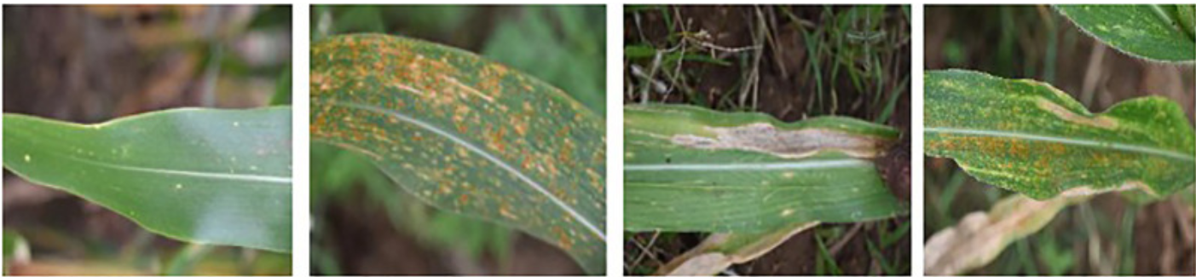
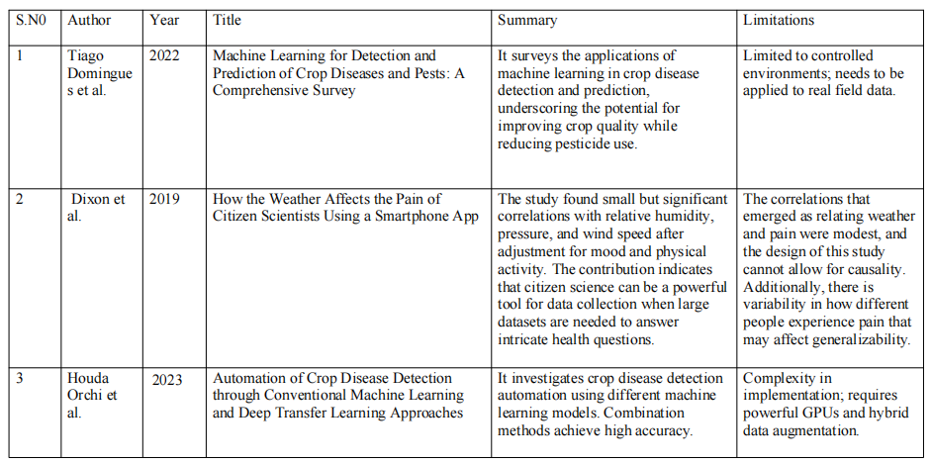
mini
LITERATURE REVIEW
01
LITERATURE
REVIEW
Next

Slide 6
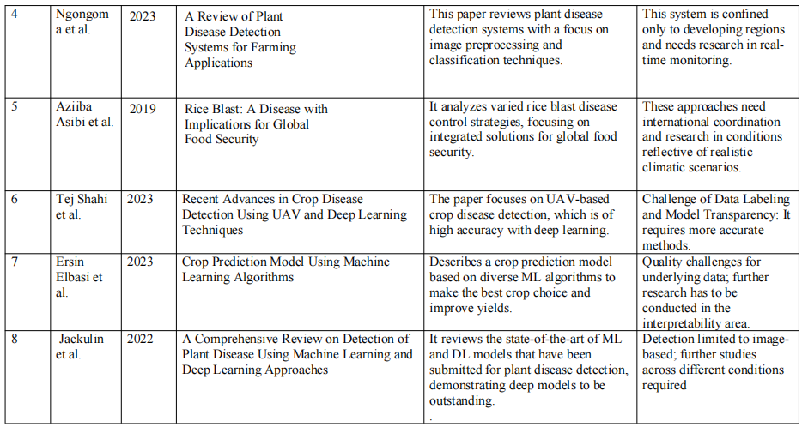
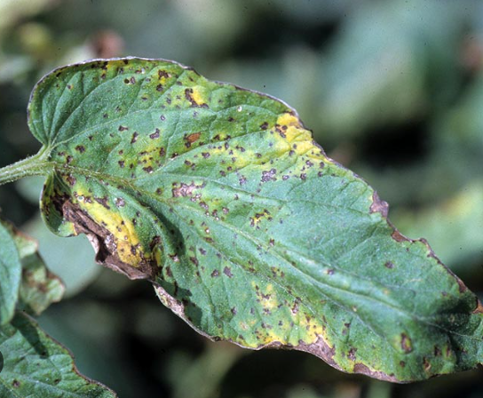
LITERATURE REVIEW
mini.
LITERATURE REVIEW
02
03
04
05
Next

Slide 7
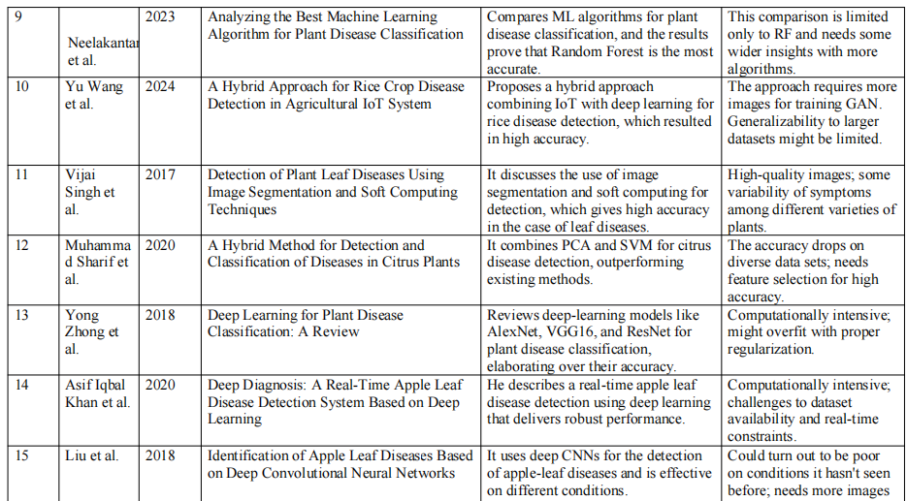
mini
LITERATURE REVIEW
01
LITERATURE
REVIEW
Next

Slide 8
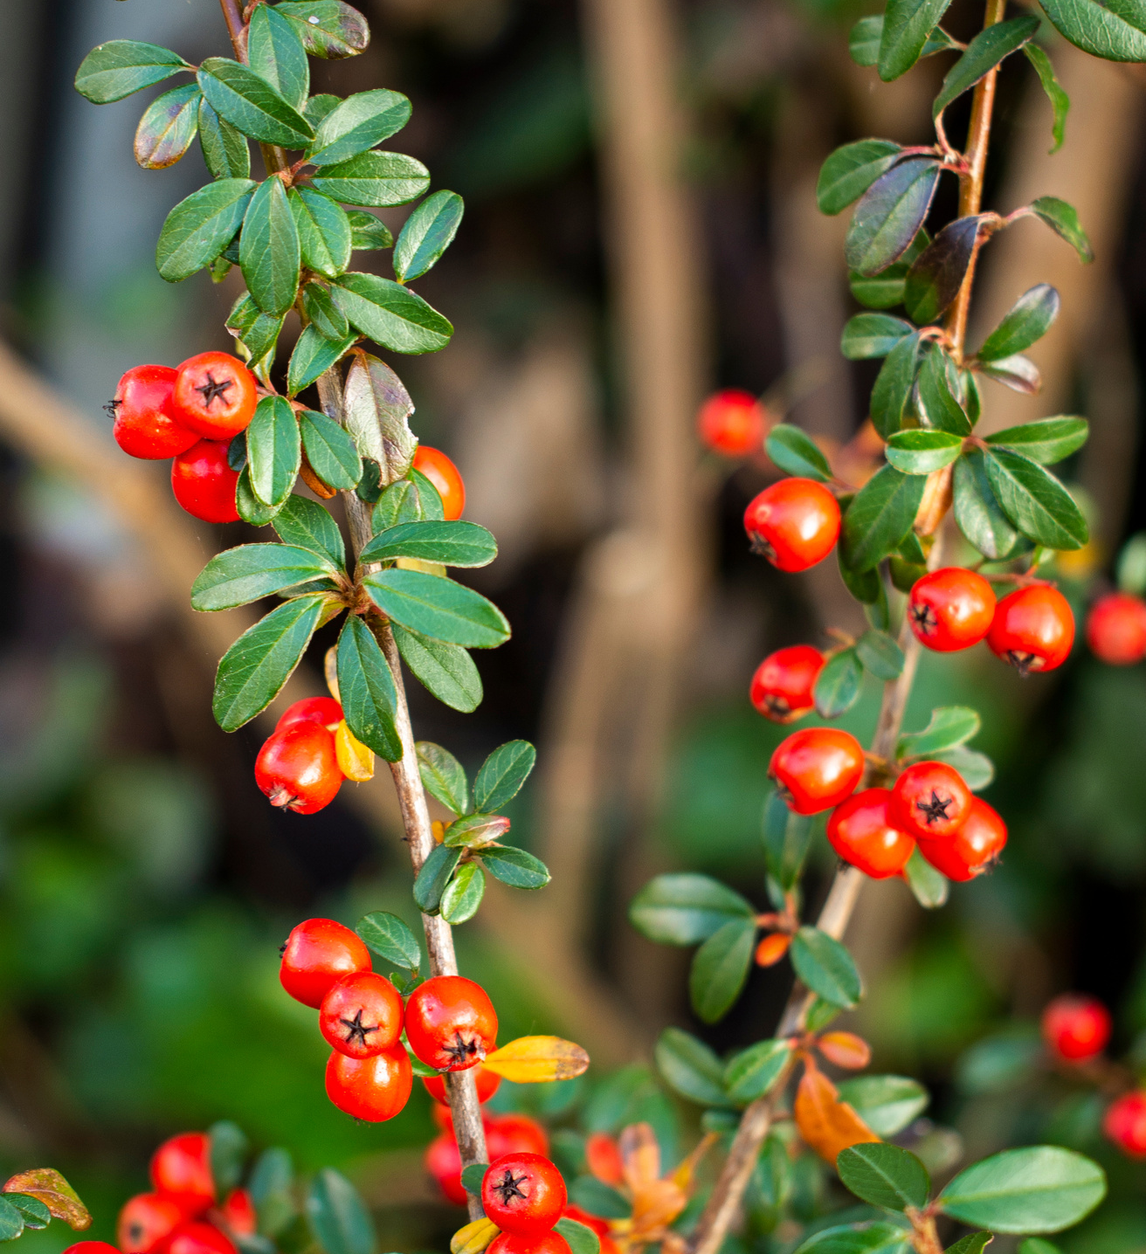
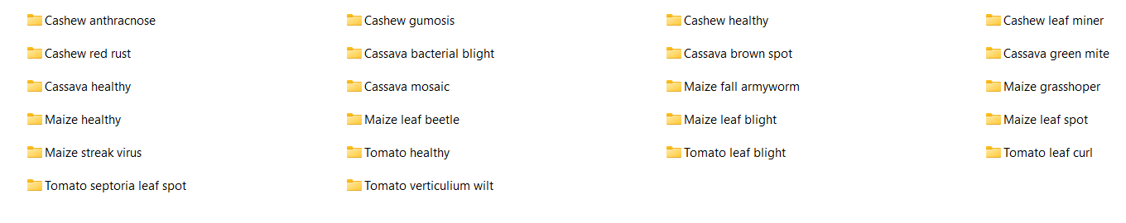
DATA SET
MINI PROJECT
DATA
Ghanaian Farms
cashew - 5 classes
cassava - 5 classes
maize - 7 classes
tomato - 5 classes
Ghana is a country in West Africa
Next

Slide 9
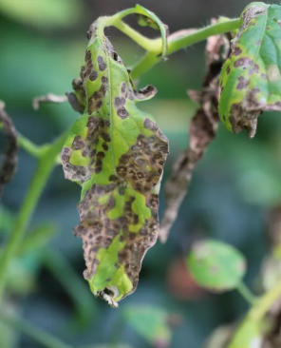
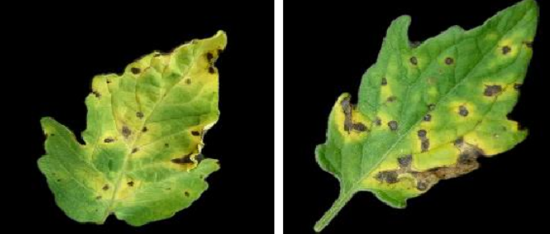
MINI PROJECT
Scope
scope & problem statement
The objective of this work is to create an advanced model that combines Machine Learning (ML) and Deep Learning (DL) approaches to accurately predict crop diseases and recommend pesticides.
The real-world data from Ghanaian farms and synthetic data which improves the robustness and accuracy of prediction models. The study includes field deployment of these models in Ghana forms to examine their efficacy in enhancing agricultural results.
Crop diseases in Ghana forms are a major hazard to agriculture, resulting in lower yields and large economic losses. Traditional techniques of disease prediction and pesticide recommendation are frequently ineffectual due to insufficient data and a lack of real-time information.
This study addresses these issues by combining different data sources with machine learning and deep learning approaches to create accurate and scalable solutions for disease prediction and pesticide recommendation, with the ultimate goal of improving crop quality and yield across countries and crops.
Next

Slide 10
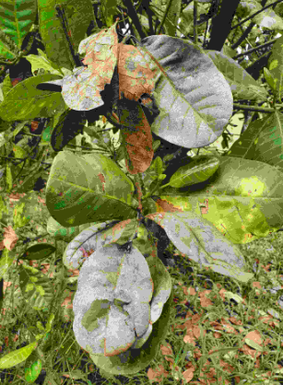
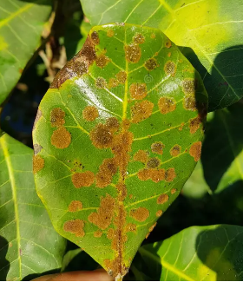
reseach challenges
MINI PROJECT
Reseach challenges
Data Quality and Integration: Integrating local real-world data from the Ghanaian farms with generated synthetic data raises issues of integration, consistencyand context relevant.
Predict Disease: Use ML and DL model to predict disease which requires high accuracy. High degree of accurate patter recognition is essential for prediction of pesticide recommendation with the use hyperparameters tuning in sophisticated models as well
Computational Resources: It requires massive computational power to train large scale DL models, which might not be available in resource-limited settings.
Field Validation: This step involves the implementation of models and their validation under real-world farming conditions since field data, as well environmental factors might vary greatly.
Scalable: Make sure it can be scaled for different crops and regions from Ghana.
Next

Slide 11
Reseach Objective
MINI PROJECT
Reseach objective
Build and Train Models: Develop ML/DL models (using the Ghana farm integrated data, synthetics) to predict diseases of crop.
Accuracy and Efficiency Check: Undertake Wastewater treatment plant field trials to evaluate the performance of new models with previously existing methods for prediction.
Improve Usability: Design an easy interface for farmers to easily find the predictions and forecasting.
Scalability: Examine the scalability of taking what we have built and transferring it to other regions, as well in regards with crops.
Next

Slide 12
MINI PROJECT
LIMITATIONS & FUTUREWORK
Limitations
Data Availability: Lack of good quality real farm data from Ghanaian farms file; this may reduce model performance.
Model Generalization — Models are trained on specific data sets and can be transfer learned to some extent, but models cannot generalize across different regions or crop types without fine-tuning adaptations.
Lack of Resources: There might be a finite amount of computational and financial resources available to train and deploy sophisticated ML/DL models.
Field Implementation Variability in field conditions and farmer practices may limit the applicability and effectiveness of recommendations.
Next

Slide 13
MINI PROJECT
FUTUREWORK
Futurework
Enhance Model: Leverage sophisticated DL (Deep Learning) and hybrid techniques,test out more advanced models for even better predictions/recommendations.
Cross-Regional Validation : The validated models should be tested and fine-tuned for application in other regions and crop types.
IoT: connect Internet of Things (IoT) devices and sensors to gather the real time data for more accurate predictions and recommendations.
Next

Slide 14
MINI PROJECT
Conclusion
conclusion
This study proposes a novel strategy to crop disease prediction and pesticide recommendation that combines Machine Learning (ML) and Deep Learning (DL) algorithms with data from both real-world farms in Ghana and synthetic sources.
The proposed method solves the inefficiencies of previous methods by providing an effective, automated solution that improves disease diagnosis and pesticide recommendations across a wide range of crops and environmental circumstances.
The model, which uses advanced algorithms and a user-friendly interface, not only reduces agricultural practices but also contributes to higher crop yields, fewer dependencies on physical testing, and greater agricultural sustainability, ultimately helping to mitigate the threat of crop disease-related food shortages.
Next

Slide 15
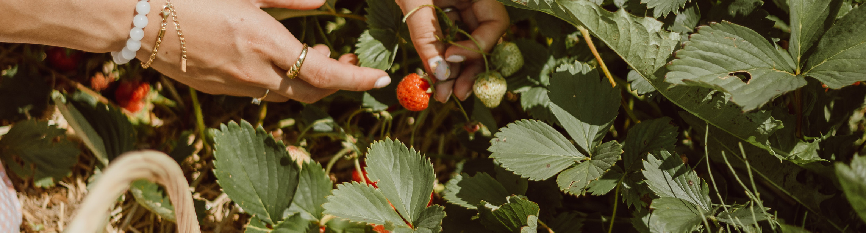
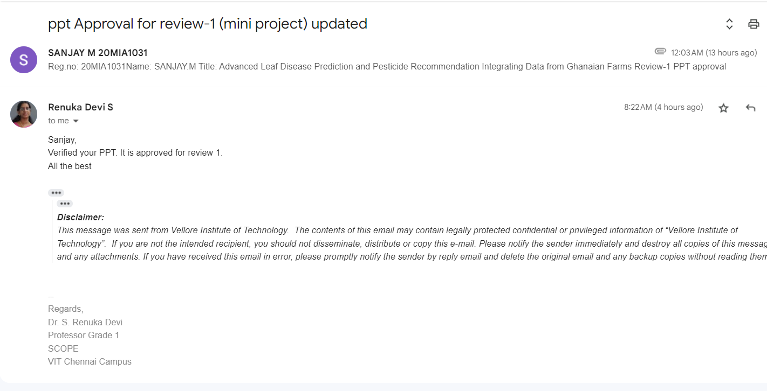
MINI PROJECT
Approval
Guide Approval picture
Next

Slide 16
MINI PROJECT
References
REFERENCES
[1] Domingues, T., Brandão, T., & Ferreira, J. C. (2022). Machine Learning for Detection and Prediction of Crop Diseases and Pests: A Comprehensive Survey. Agriculture, 12(9), 1350. https://doi.org/10.3390/agriculture12091350
[2]Dixon, W. G., Beukenhorst, A. L., Yimer, B. B., Cook, L., Gasparrini, A., El-Hay, T., Hellman, B., James, B., Vicedo-Cabrera, A. M., Maclure, M., Silva, R., Ainsworth, J., Pisaniello, H. L., House, T., Lunt, M., Gamble, C., Sanders, C., Schultz, D. M., Sergeant, J. C., & McBeth, J. (2019). How the weather affects the pain of citizen scientists using a smartphone app. Npj Digital Medicine, 2(1). https://doi.org/10.1038/s41746-019-0180-3
[3]Orchi, H., Sadik, M., Khaldoun, M., & Sabir, E. (2023). Automation of Crop Disease Detection through Conventional Machine Learning and Deep Transfer Learning Approaches. Agriculture, 13(2), 352. https://doi.org/10.3390/agriculture13020352
[4]Ngongoma, M. S. P., Kabeya, M., & Moloi, K. (2023). A Review of Plant Disease Detection Systems for Farming Applications. Applied Sciences, 13(10), 5982. https://doi.org/10.3390/app13105982
[5]Asibi, A. E., Chai, Q., & Coulter, J. A. (2019). Rice Blast: A Disease with Implications for Global Food Security. Agronomy, 9(8), 451. https://doi.org/10.3390/agronomy9080451
Next

Slide 17

MINI PROJECT
REFERENCES
[6]Shahi, T. B., Xu, C.-Y., Neupane, A., & Guo, W. (2023). Recent Advances in Crop Disease Detection Using UAV and Deep Learning Techniques. Remote Sensing, 15(9), 2450. https://doi.org/10.3390/rs15092450
[7]Elbasi, E., Zaki, C., Topcu, A. E., Abdelbaki, W., Zreikat, A. I., Cina, E., Shdefat, A., & Saker, L. (2023). Crop Prediction Model Using Machine Learning Algorithms. Applied Sciences, 13(16), 9288. https://doi.org/10.3390/app13169288
[8]Jackulin, C., & Murugavalli, S. (2022). A comprehensive review on detection of plant disease using machine learning and deep learning approaches. Measurement: Sensors, 24, 100441. https://doi.org/10.1016/j.measen.2022.100441
[9]Neelakantan . P. (2023). Analyzing the best machine learning algorithm for plant disease classification. Materials Today: Proceedings, 80, 3668–3671. https://doi.org/10.1016/j.matpr.2021.07.358
[10]Wang, Y., Rajkumar Dhamodharan, U. S., Sarwar, N., Almalki, F. A., Naith, Q. H., R, S., & D, M. (2024). A hybrid approach for rice crop disease detection in agricultural IoT system. Discover Sustainability, 5(1). https://doi.org/10.1007/s43621-024-00285-4
Next

Slide 18
MINI PROJECT
References
REFERENCES
[11] Singh, V., & Misra, A.K. (2017). Detection of plant leaf diseases using image segmentation and soft computing techniques. Information Processing in Agriculture, 4(1), 41-49. https://doi.org/10.1016/j.inpa.2016.10.005
[12] Sharif, M., Khan, M. A., Iqbal, Z., Azam, M. F., Lali, M. I. U., & Javed, M. Y. (2018). Detection and classification of citrus diseases in agriculture based on optimized weighted segmentation and feature selection. Computers and Electronics in Agriculture, 150, 220-234. https://doi.org/10.1016/j.compag.2018.04.023
[13] Zhong, Y., & Zhao, M. (2020). Research on deep learning in apple leaf disease recognition. Computers and Electronics in Agriculture, 168, 105146. https://doi.org/10.1016/j.compag.2019.105146
[14] Khan, A. I., Quadri, S.M.K., Banday, S., & Shah, J.L. (2022). Deep diagnosis: A real-time apple leaf disease detection system based on deep learning. Computers and Electronics in Agriculture, 198, 107093. https://doi.org/10.1016/j.compag.2022.107093
[15] Liu, B., Zhang, Y., He, D., & Li, Y. (2018). Identification of Apple Leaf Diseases Based on Deep Convolutional Neural Networks. Symmetry, 10(1), 11. https://doi.org/10.3390/sym10010011
data set link : https://www.kaggle.com/datasets/nirmalsankalana/crop-pest-and-disease-detection/data
Next

Slide 19
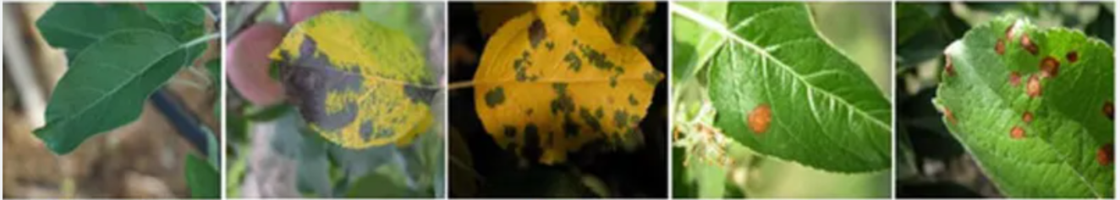
Thank You
Go Green Save Earth

